Slide 1



Smart Attend
Crime Rate Analysis
Team Members:
Awais Ahmad Khan
Khalid Dhabbah
Shah Rukh Khan

Slide 2
DATASET
KC Crime data that we are using has following statistics which makes it an eligible big data problem.
1121574 Records
21 Columns
Size of File is 152MB in Size
Has around 9 years worth of crime reporting just for KC
Columns
Location
nature of crime
number of people affected or involved etc
We used this dataset to create a basic analysis architecture so when we extend this to the combined data of all the other cities in US, it will be able to adapt to the big data.
Smart Attend

Slide 3
Feature Engineering
1- Removing some unwanted features.
2- Completing the obvious one.
3- Using a unique category.
4- Using the mean function.
5. Cleaning the rest.
Smart Attend

Slide 4
Team Collaboration
Each of us worked on same dataset but with different technologies.
We worked to maximize the analysis.
Same dataset was explored in new ways using different methodologies.
The results and analysis of our individual contributions have been summed up in the report.
Smart Attend

Slide 5
Hive
Hive is a tool which we can read, write, and manage large dataset in distributed storage using SQL.
The analysis performed resulted was as follows:
Find the number of crime types that happened in Kansas City.
Find how many crimes were in 2016 and 2018 based on males’ and females’ involvement.
Find how many people were arrested in the Plaza Area.
Find how many victims were in 2016.
Find how many suspects based on their race.
Smart Attend

Slide 6
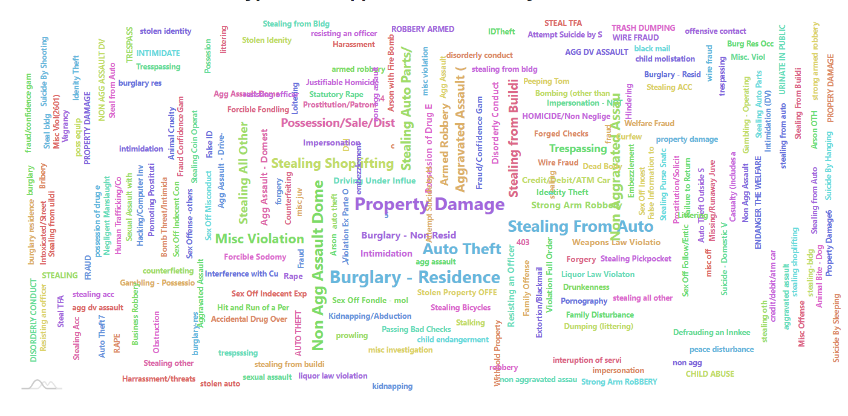
Results
Smart Attend

Slide 7
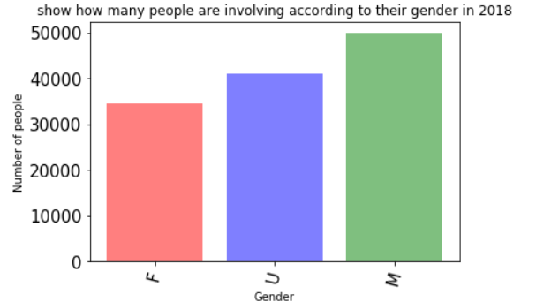
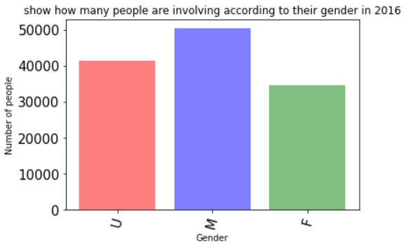
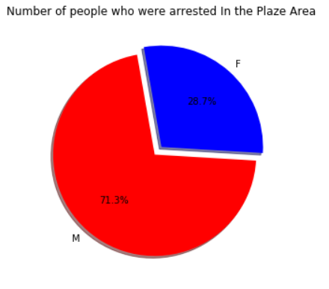
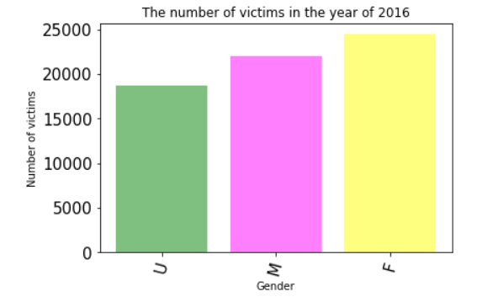
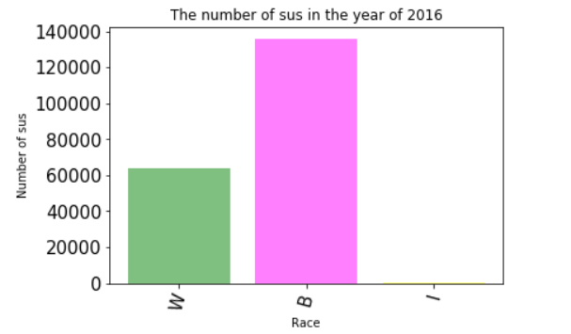
Results
Smart Attend

Slide 8
PYSPARK UDF
Shah Rukh worked on Implementing UDF functions using Pyspark.
The analysis performed resulted was as follows:
We can get all the crimes in a certain radius of an EpiCenter
We can get all reported crimes in a certain time span
We can get all unique type of crimes that happened in a radius
We can get Safety Level of a certain area that changes wrt time span
We can get reportings for a single type of crime in a Radius of our choice
Smart Attend

Slide 9
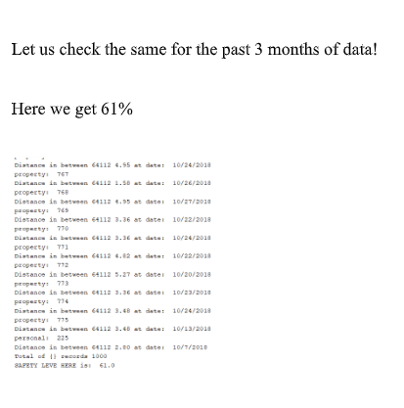
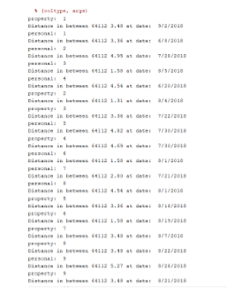
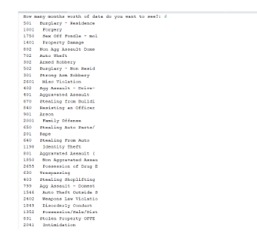
Results
Smart Attend

Slide 10
CASSANDRA
Shah Rukh worked on Implementing CQL Queries.
The analysis performed was as follows:
First Created a Keyspace
Created a Table for the dataset
Copied dataset and applied queries such as:
We can get all listing of a certain type of crime:
SELECT * from CRIMET WHERE Offense=’501’ ALLOW FILTERING;
We can count the total reportings of a crime in a certain zipcode or a certain type of crime
SELECT COUNT(*) from CRIMET WHERE Zipcode=’64112’ ALLOW FILTERING;
Smart Attend

Slide 11
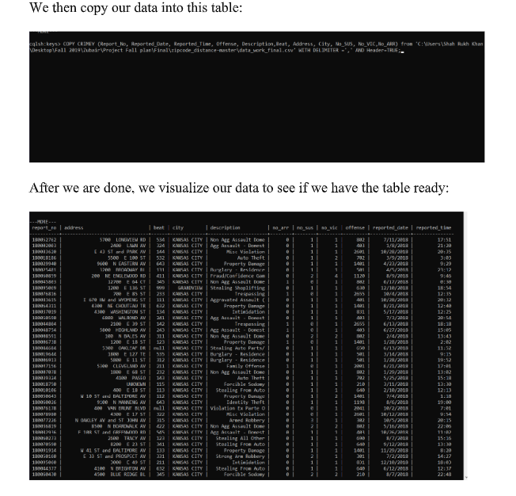
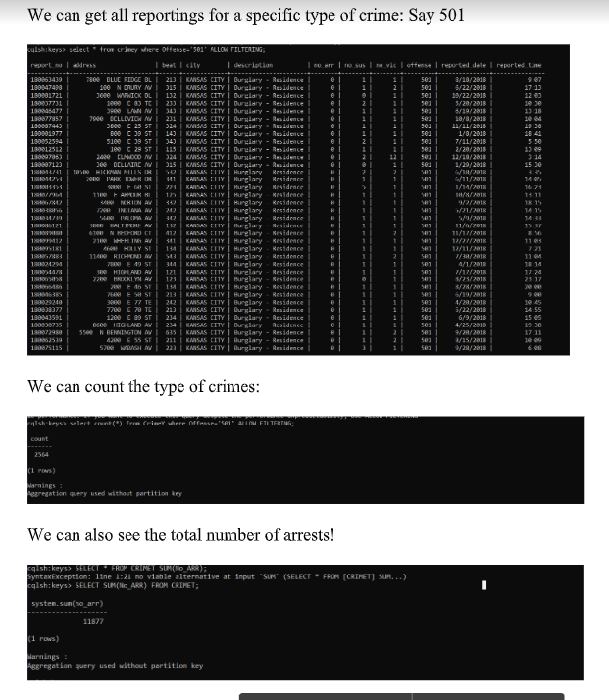
Results
Smart Attend

Slide 12
Time Based Analysis
Spark SQL Context
Time based (Yearly, Monthly and Weekly)
Crime Occurred in each month of every Year
Category based Occurrence of each crime per year
Maximum Crime Category occurred in each year
Weekly analysis of maximum and minimum crime
More crimes on weekends or weekdays?
Maximum Crimes on Mondays
Minimum crimes on sundays
Smart Attend

Slide 13
Partition Based Analysis
Pyspark Textstream
Division of data into years with only one crime (csv file)
Analysis through spark text stream
Accessing specific data and generating a text file for better visualization.
Smart Attend

Slide 14
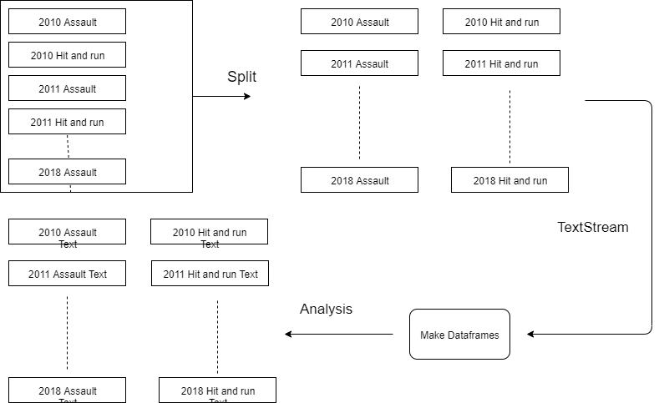
Smart Attend

Slide 15
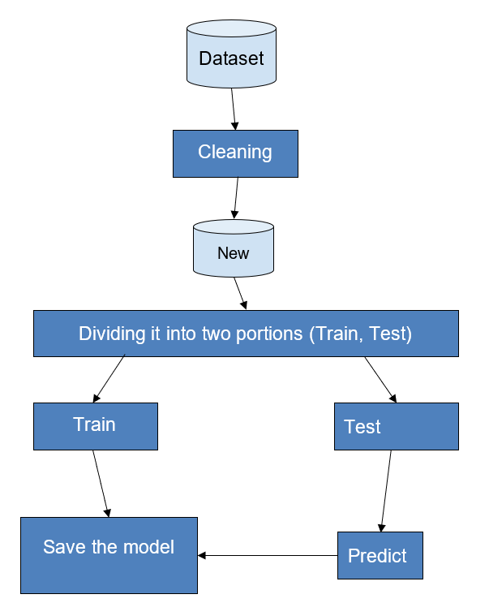
Analytics
We have done some machine learning algorithms on
our dataset; for instance:
Random Forest.
Naive Bayes.
Decision tree.
Smart Attend

Slide 16
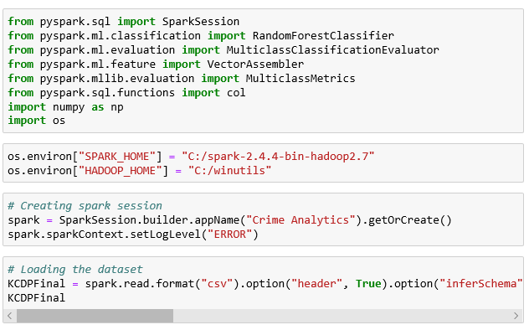


Analytics
We imported the most important libraries.
We used SparkContext.
We had the dataset ready for training.
Smart Attend

Slide 17
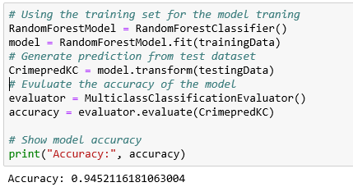
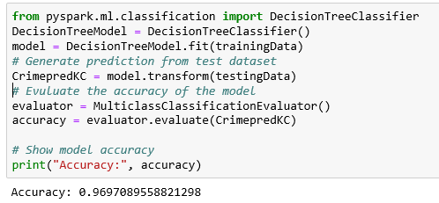
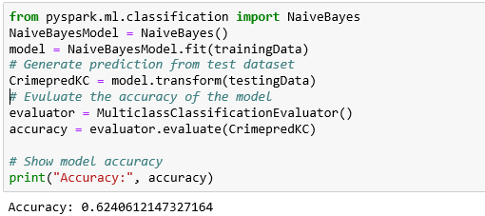
Analytics
Smart Attend

Slide 18
Future Objectives
Time data ( Hours, Minutes, Seconds)
Deep Analysis on the basis of hourly data.
Extend the functionality from text stream to sock stream
Integration of visualization with the data.
Smart Attend

Slide 19

[1]. KCPD Crime Data 2018: https://data.kcmo.org/Crime/KCPD-Crime-Data-2018/dmjw-d28i/data.
[2]. Pandas.DataFrame.dropna: https://pandas.pydata.org/pandas-docs/stable/reference/api/pandas.DataFrame.dropna.html
[3]. Drop Rows with NAN/ NA: http://www.datasciencemadesimple.com/drop-rows-with-nan-na-drop-missing-value-in-pandas-python-2/
[4]. Pandas.DatetimeIndex: https://pandas.pydata.org/pandas-docs/version/0.23.4/generated/pandas.DatetimeIndex.html
[5]. Pivot Tables: https://www.excel-easy.com/data-analysis/pivot-tables.html
[6]. Apache-hive: https://mapr.com/products/apache-hive/
[7]. Using Hive to perform some queries: https://github.com/Dhabbah/CSEE5590-490-Big-Data-Programming/wiki/ICP4
[8]. Numpy queries on Dataframes. https://docs.scipy.org/doc/numpy/reference/arrays.indexing.html
[9]. DSTREAMS examples https://gokhanatil.com/2018/04/pyspark-examples-5-discretized-streams-dstreams.html
[10]. Dataframe and RDDs https://medium.com/@xuweimdm/how-to-make-a-dataframe-from-rdd-in-pyspark-c34f2888ea8
[11]. Pyspark SQL modules. https://spark.apache.org/docs/2.1.0/api/python/pyspark.sql.html
[12]. User Defined Functions . https://docs.databricks.com/spark/latest/spark-sql/udf-python.html
[13]. SQL Aggregate functions. https://www.w3resource.com/sql/aggregate-functions/Max-with-group-by.php
[14]. New Column operations on dataframes. https://stackoverflow.com/questions/33681487/how-do-i-add-a-new-column-to-a-spark-dataframe-using-pyspark
[15]. Conversion of dataframe to python lists. https://stackoverflow.com/questions/38610559/convert-spark-dataframe-column-to-python-list
Reference

